Slide 1
A Backdoor Lockpick
Reversing & Subverting Phicomm’s Backdoor Protocol
Olivia Lucca Fraser
Staff Research Engineer, Zero Day Research Team
June 9th, 2023

Slide 2
Introducing the Wavlink AC1200

Slide 3
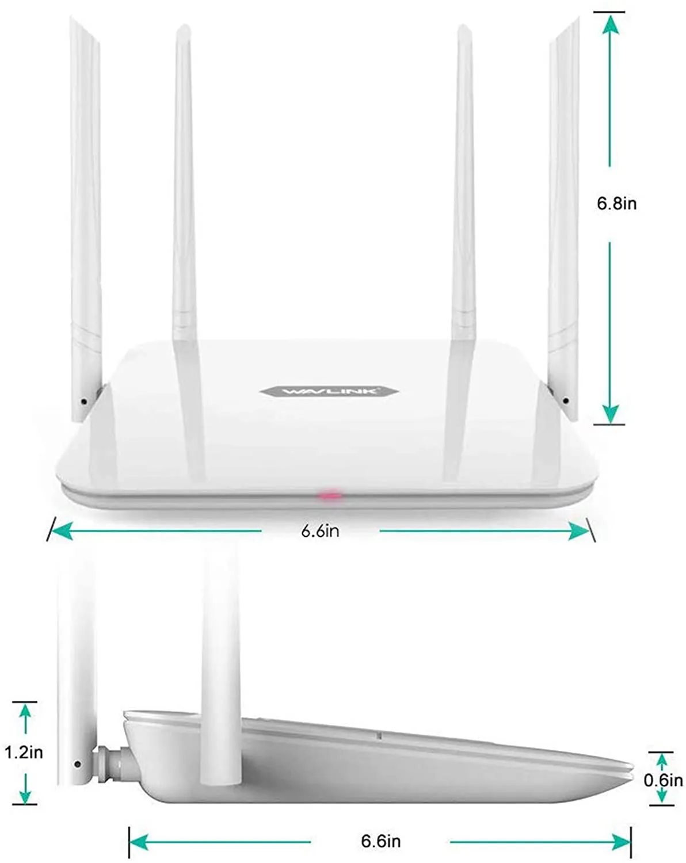
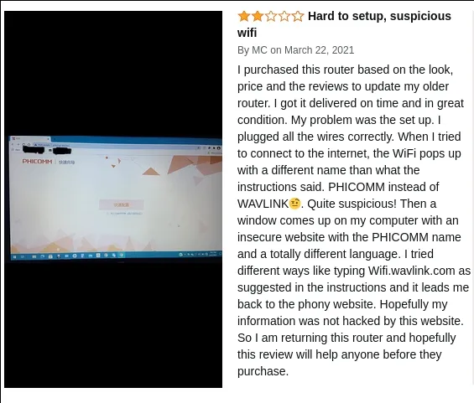
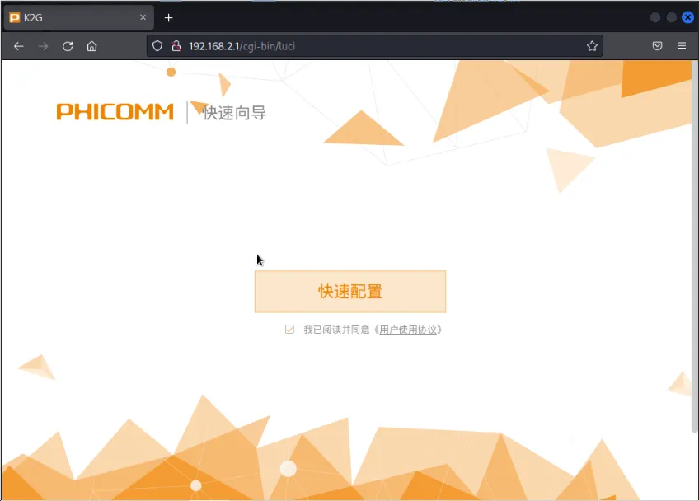
Notes:
When life gives you Phicomms…

Slide 4
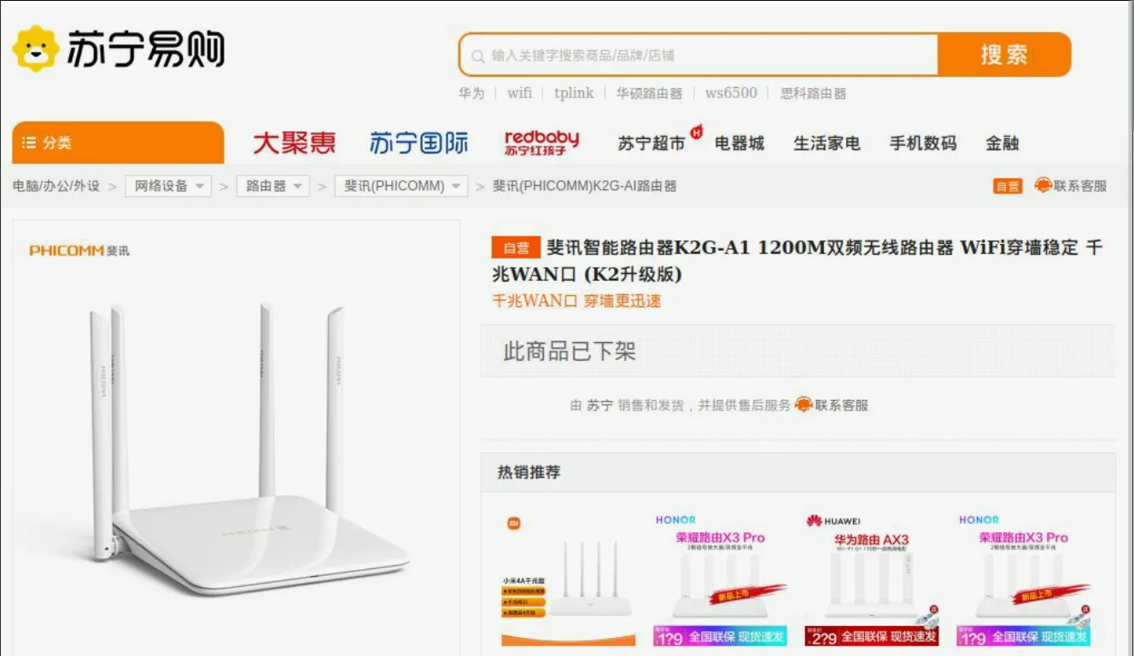
A Baidu search for “Phicomm K2G A1” brought up listings for a familiar-looking device:

Slide 5
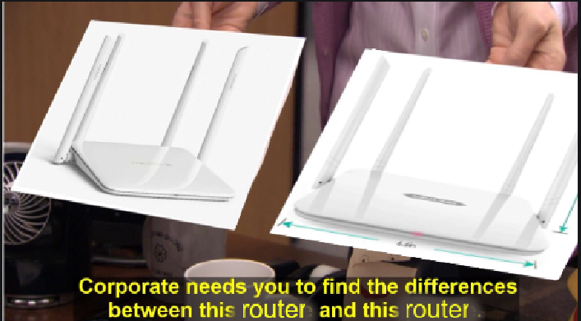

Slide 6


Slide 7
Introducing the Wavlink AC1200
Introducing the Phicomm K2G A1!

Slide 8
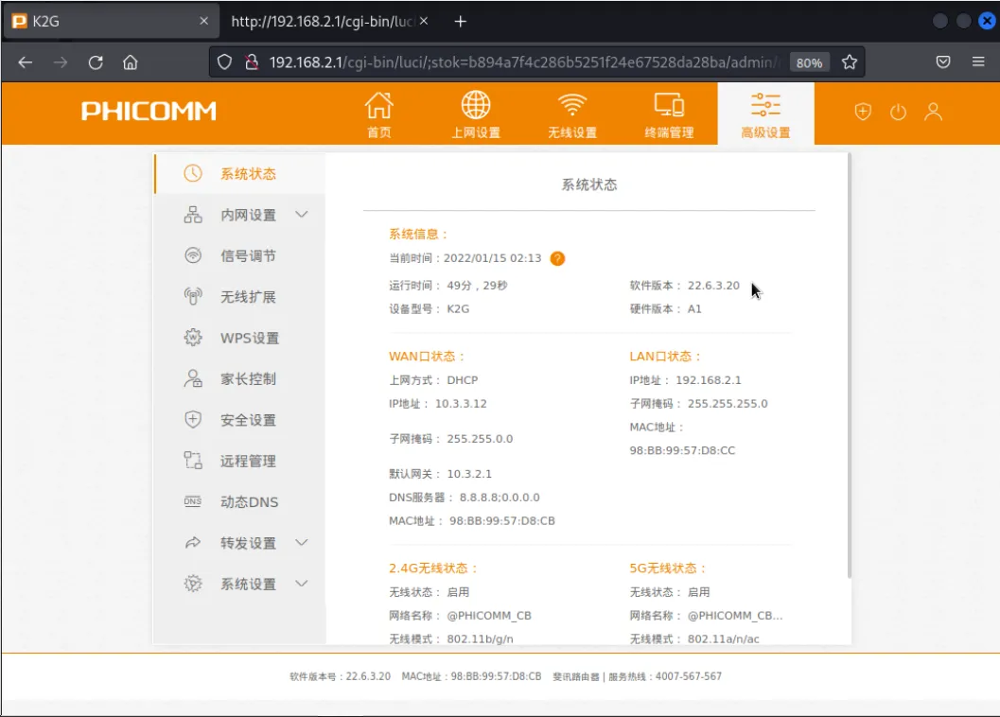
The System Status (系统状态) page identifies the device model as K2G, hardware version A1, running firmware version 22.6.3.20.

Slide 9
Using a Known Post-Auth Command Injection Vuln to Gain Shell Access

Slide 10
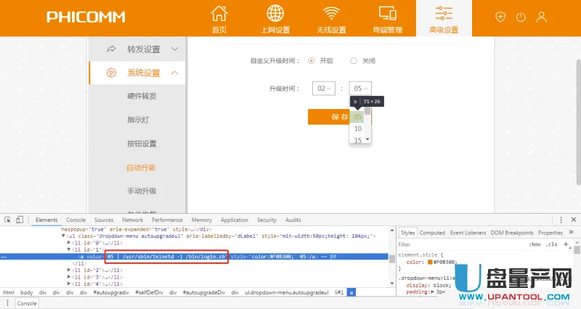

Slide 11
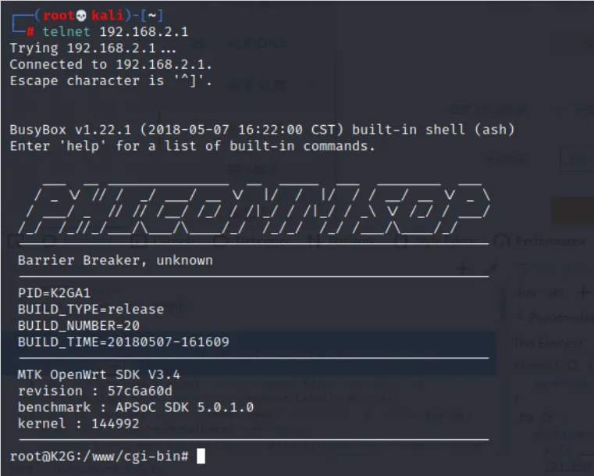

Slide 12
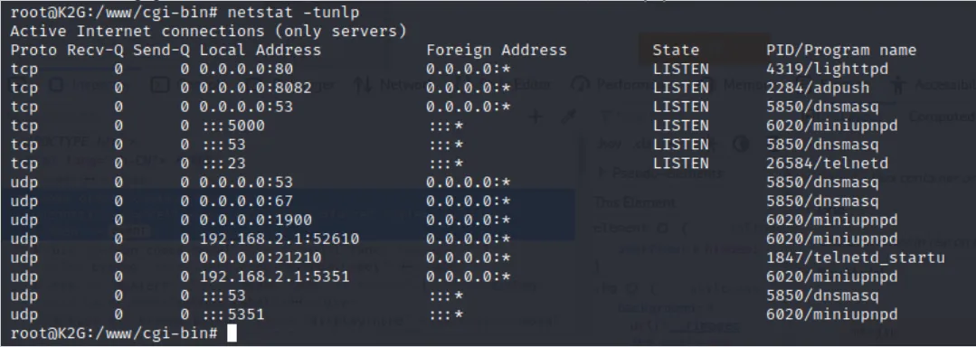

Slide 13
telnetd_startup: first impressions
32-bit MIPS (Little Endian) ELF binary
Runs as a daemon with root permissions
Listens (quietly) on UDP port 21210

Slide 14
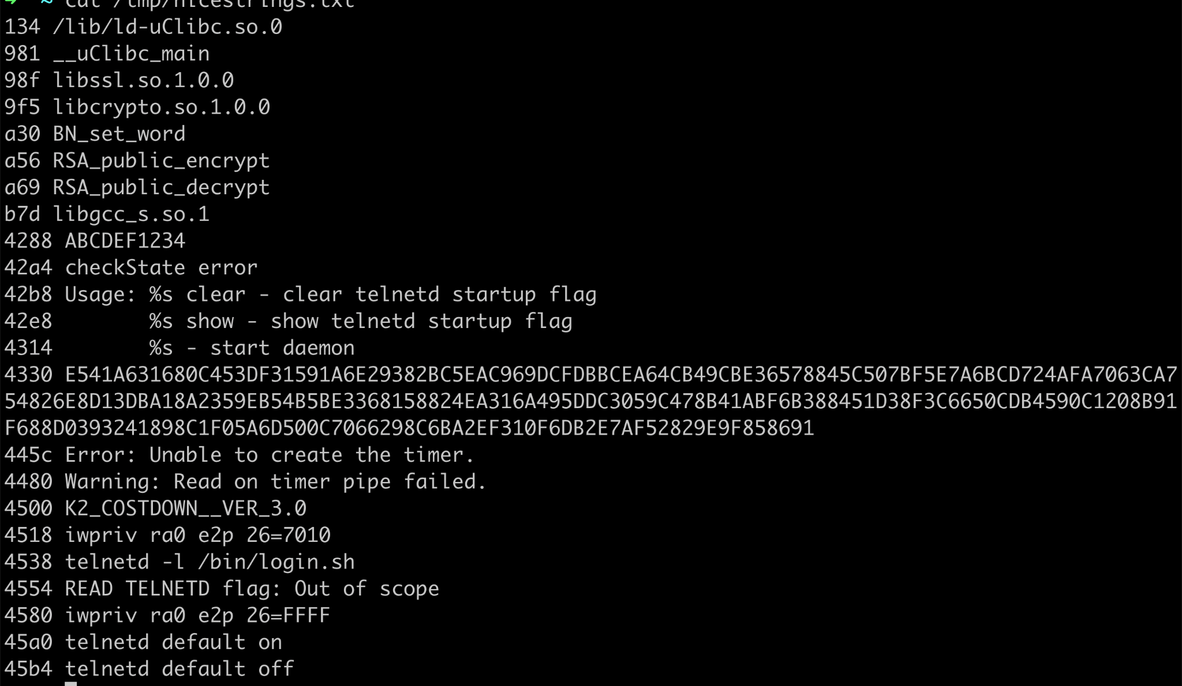
A few interesting strings…

Slide 15
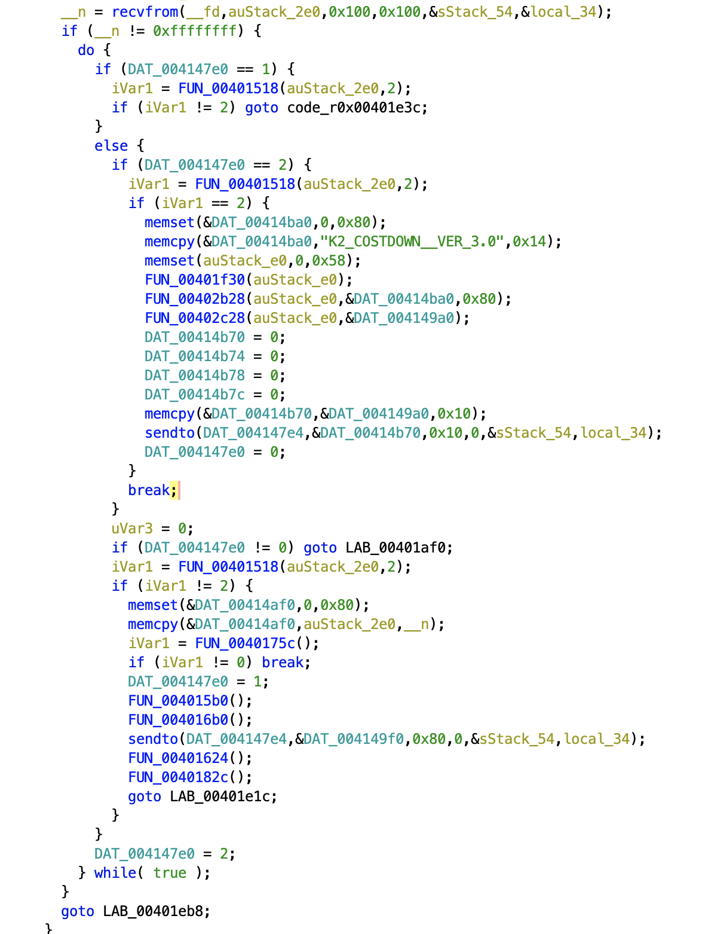
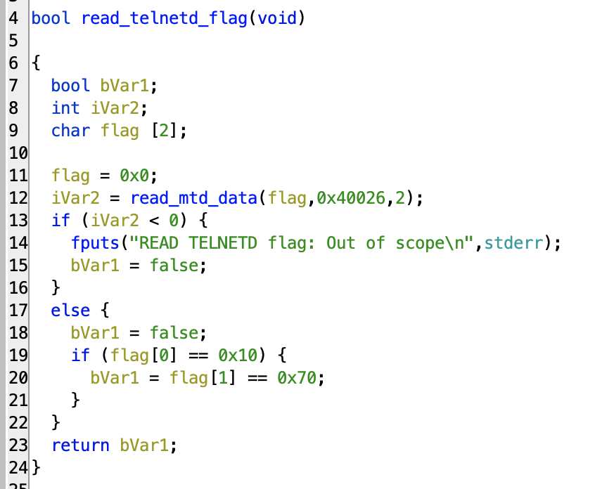
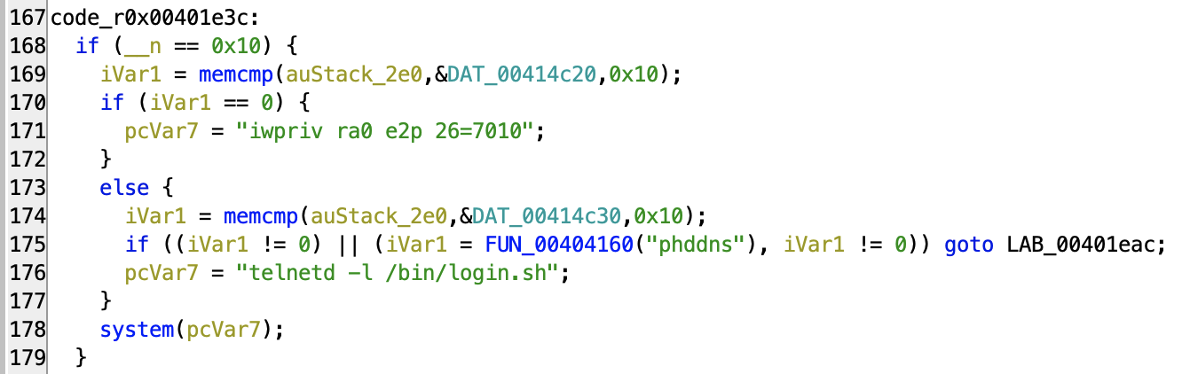
The Main State Machine of the telnetd_startup Service
We begin in state 2…
And when the service starts, it checks the EEPROM for the 0x7010 flag, and launch telnetd if it finds it.
Then go to state 0…
Then proceed to state 1
Which takes us to this final check before either
(a) 0x7010 is written to EEPROM at offset 0x26, or
(b) a telnetd service is launched

Slide 16
STATE 2
(the initial state)

Slide 17
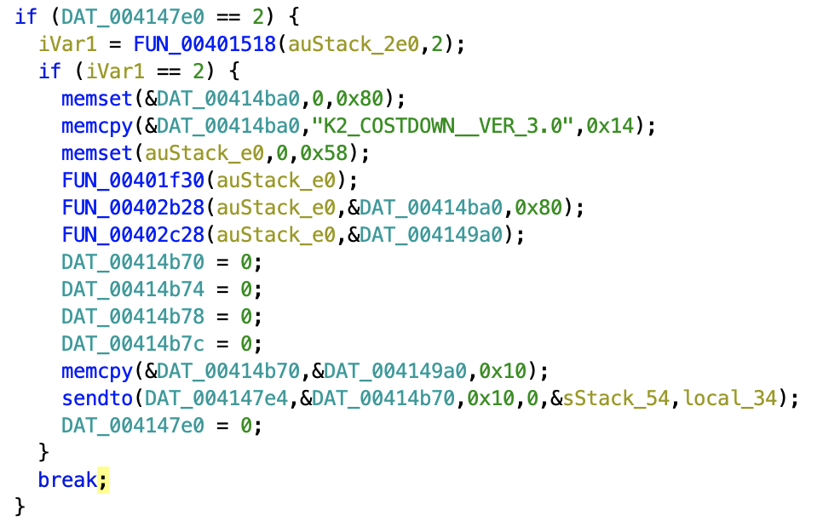

Slide 18
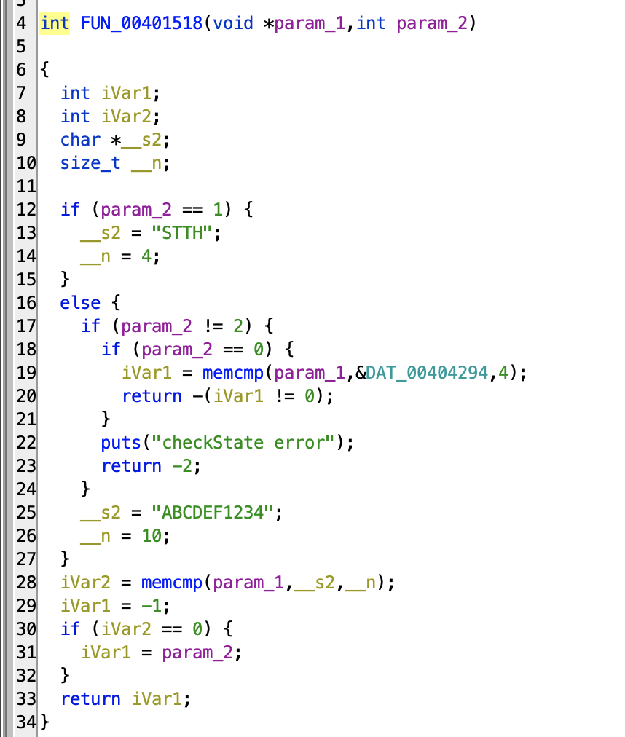
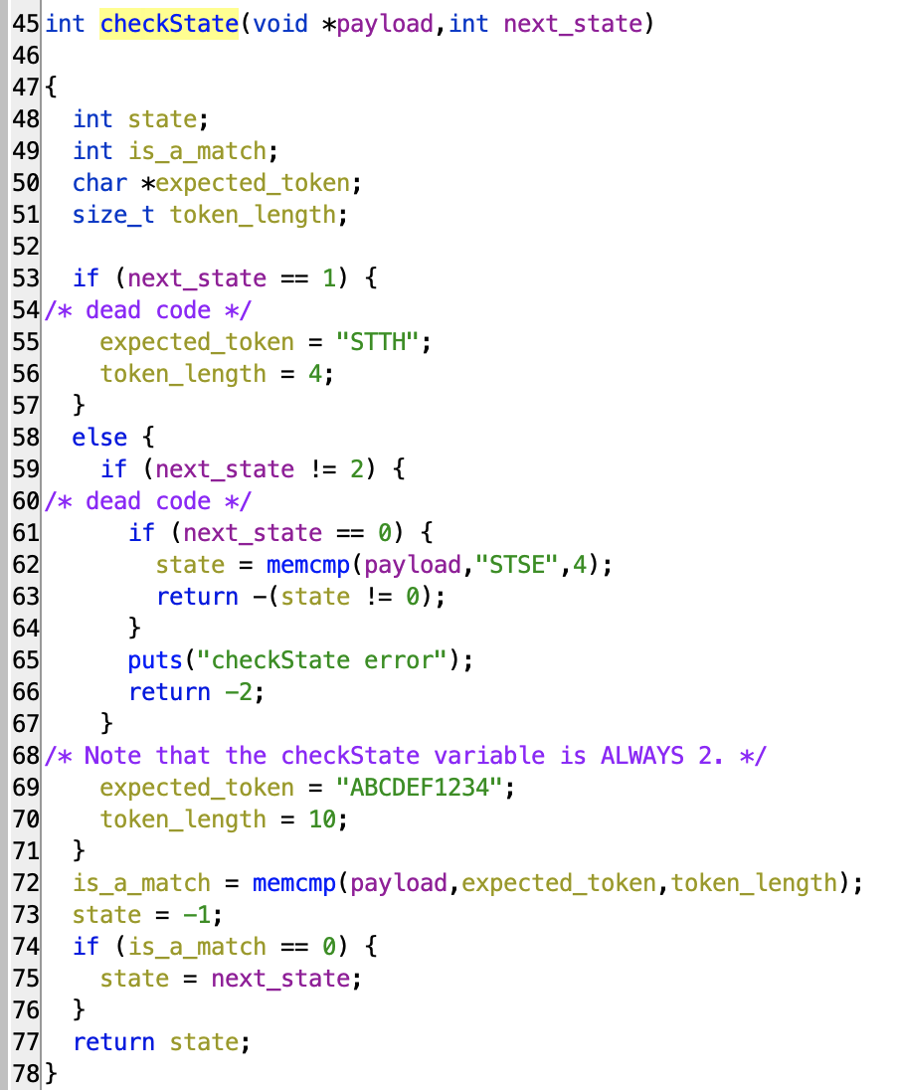

Slide 20
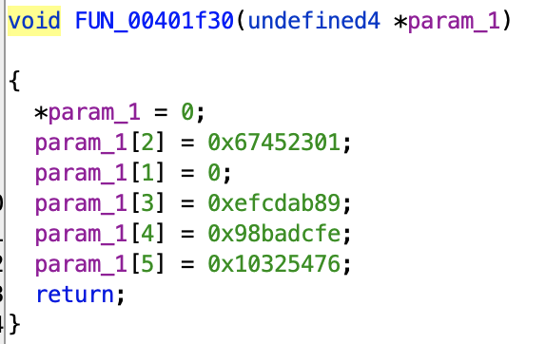
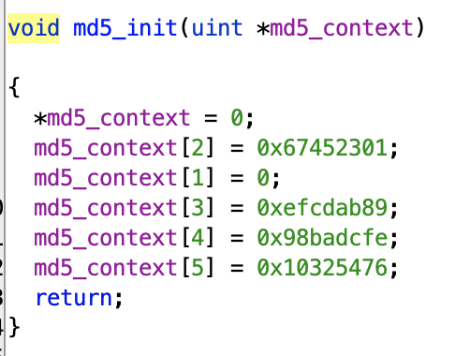
the tell-tale constants of an MD5 hash context:

Slide 21
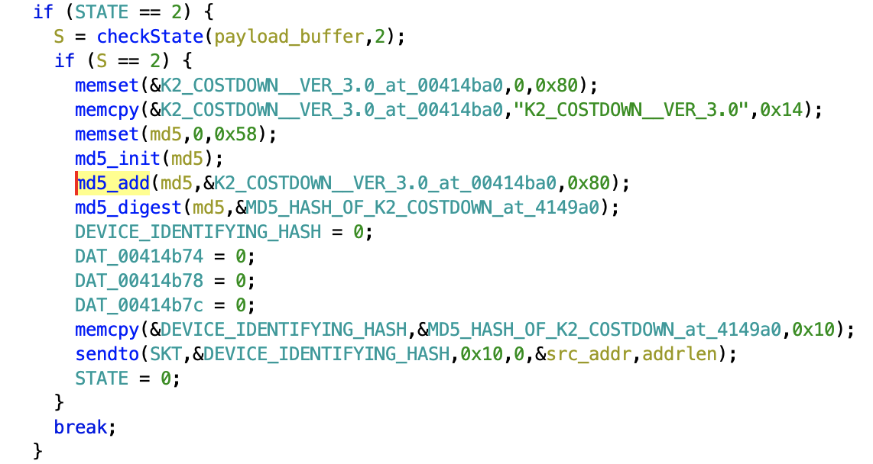
So, the service waits for the client to send the token “ABCDEF1234” and then responds with an MD5 hash of the string “K2_COSTDOWN__VER_3.0” padded with zeros to a 128-byte buffer.
It then enters STATE 0.

Slide 22
STATE 0
(the second state)

Slide 23
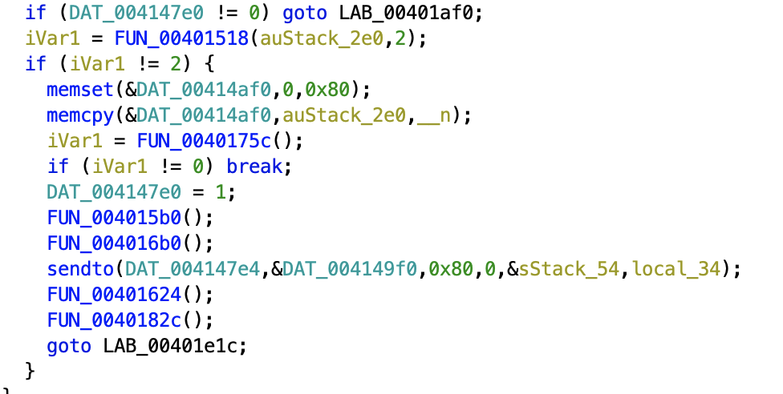

Slide 24
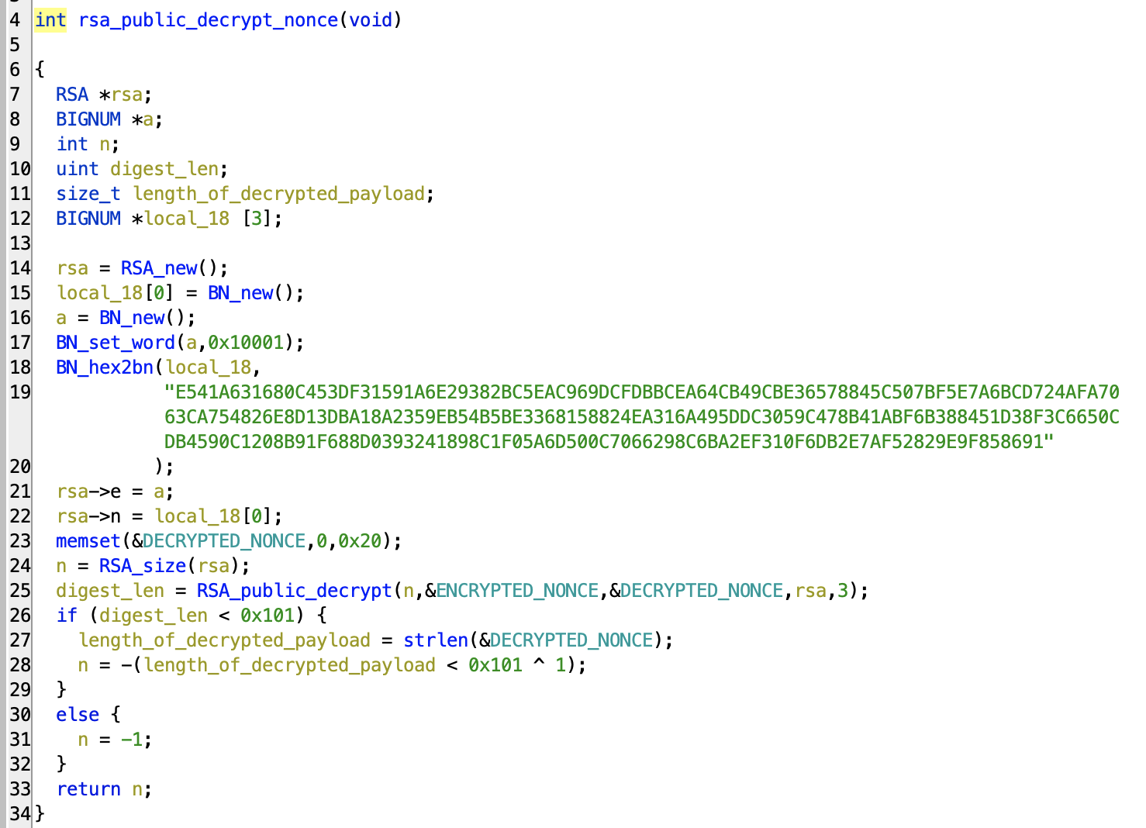

Slide 26
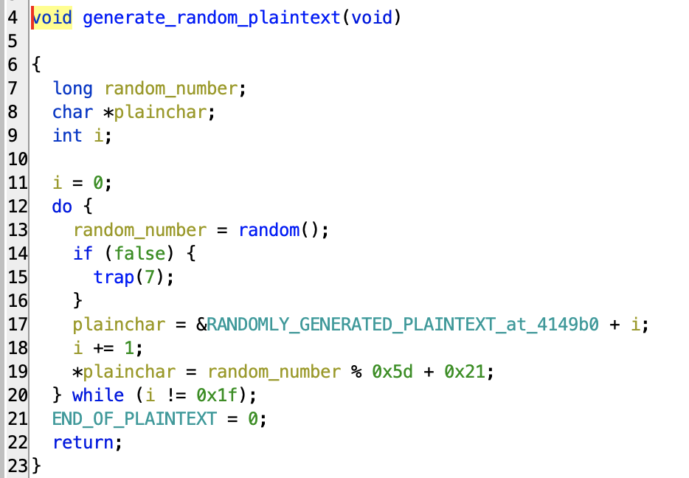

Slide 27
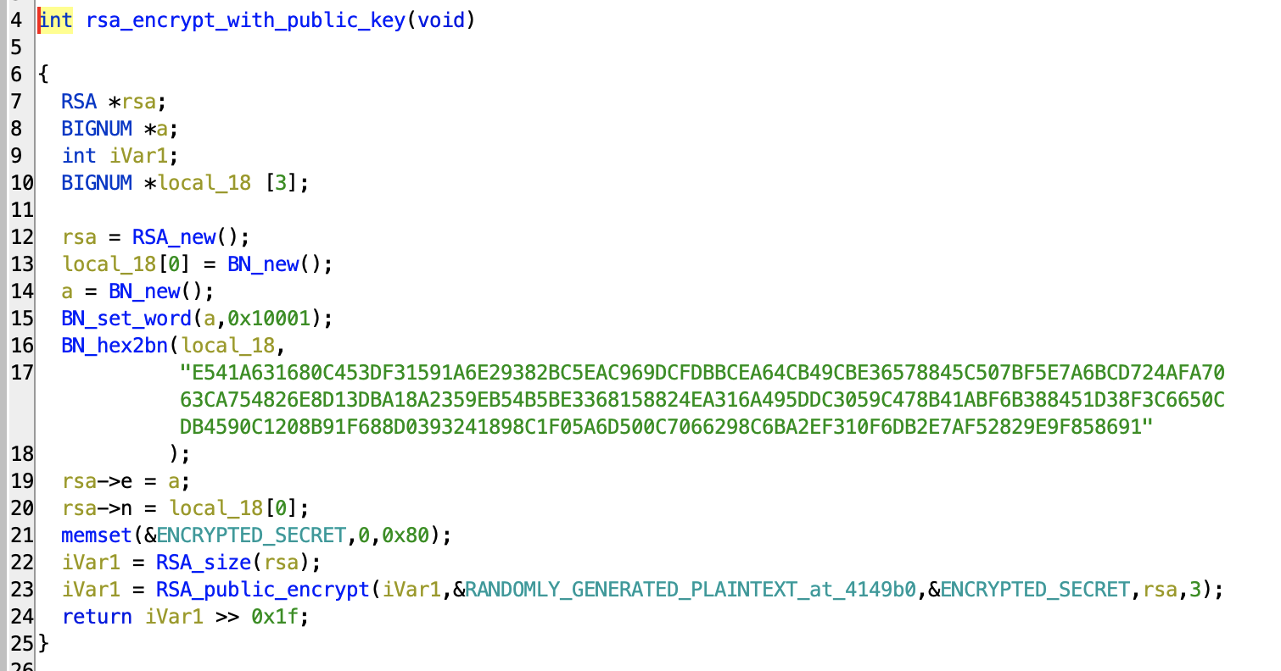

Slide 28
This encrypted secret is sent to the client, as an authentication challenge.
Meanwhile…

Slide 30
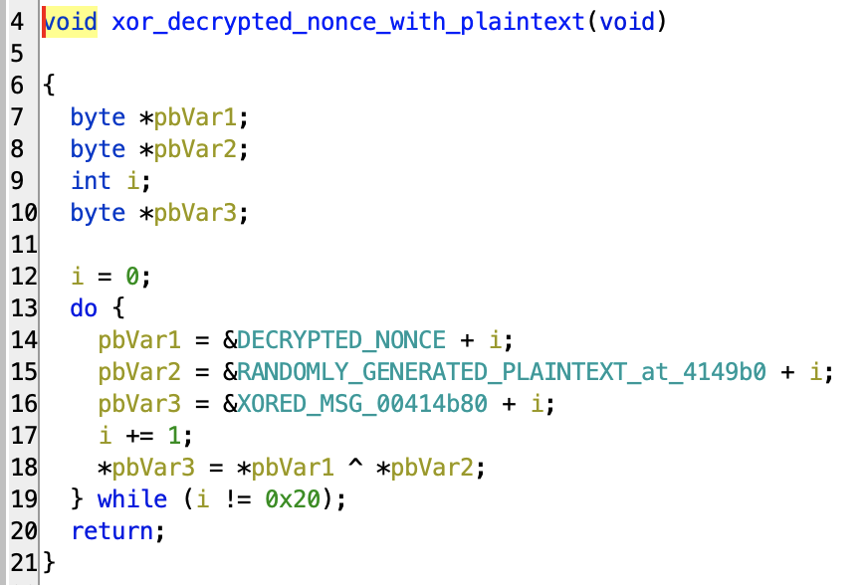

Slide 31
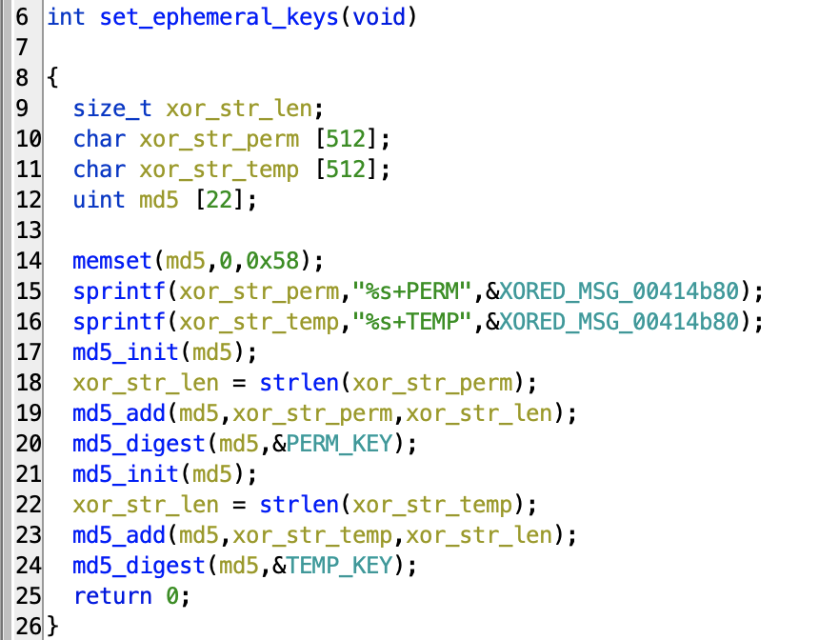

Slide 32
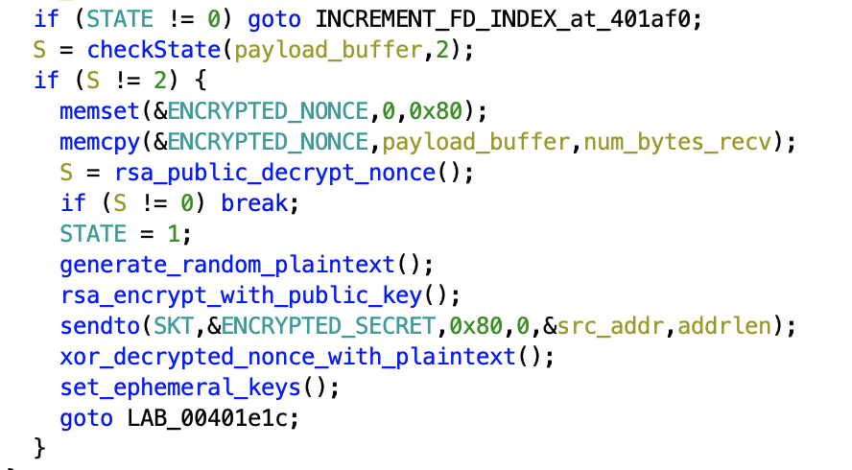

Slide 33
STATE 1
(the third and final state)

Slide 34
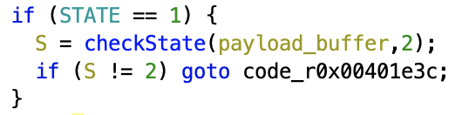
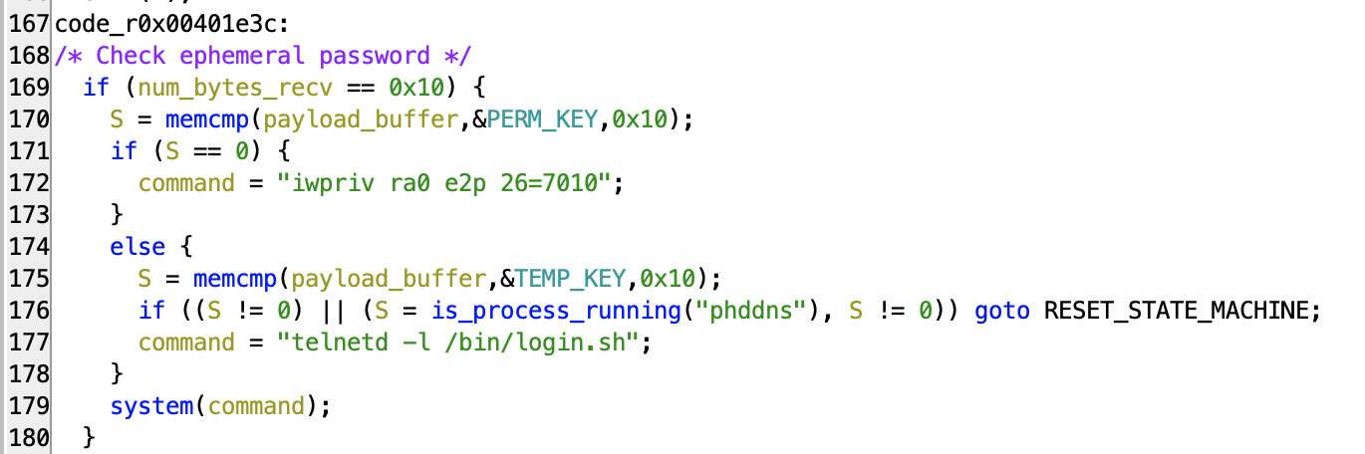
The message “ABCDEF1234” will send us back to the beginning.
But a message that matches one of these ephemeral keys will launch telnetd, either when the device reboots, or immediately.

Slide 35
How is the client supposed to determine TEMP_KEY and PERM_KEY?
Public-key-decrypted nonce
+TEMP
MD5
or
+PERM
Random string of 31 printable characters
We are expected to use the same private key we used to encrypt the nonce to decrypt the random secret that the server sends us in response.
We can then compose the ephemeral key using the same formula that the server does.

Slide 36
How is the client supposed to determine TEMP_KEY or PERM_KEY?
Public-key-decrypted nonce
+TEMP
MD5
or
+PERM
Random string of 31 printable characters
But we don’t have the private RSA key!

Slide 37
How is the client supposed to determine TEMP_KEY or PERM_KEY?
Public-key-decrypted nonce
+TEMP
MD5
or
+PERM
Random string of 31 printable characters
Maybe there’s another way…

Slide 38
How is the client supposed to determine TEMP_KEY or PERM_KEY?
Public-key-decrypted nonce
+TEMP
MD5
or
+PERM
Random string of 31 printable characters
Let’s look a bit more closely at this part here

Slide 39

Concatenating things like this would make sense if XORED_MSG_00414b80 was NECESSARILY a null-terminated string!

Slide 40
If we had a way to make the first byte of XORED_MSG_00414b80 zero, then we could easily predict the ephemeral passwords.

Slide 41
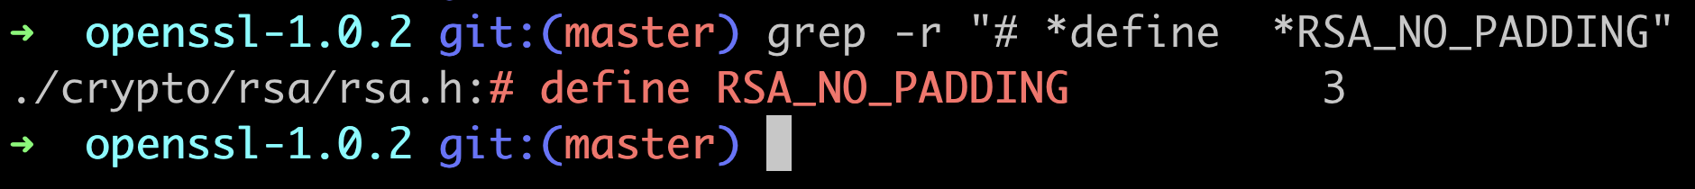
We don’t actually need the corresponding private RSA key to have SOME control over what an UNPADDED application of RSA_public_decrypt() does to our input!
If we just want to control the first byte of the plaintext, trial and error is good enough.

Slide 42
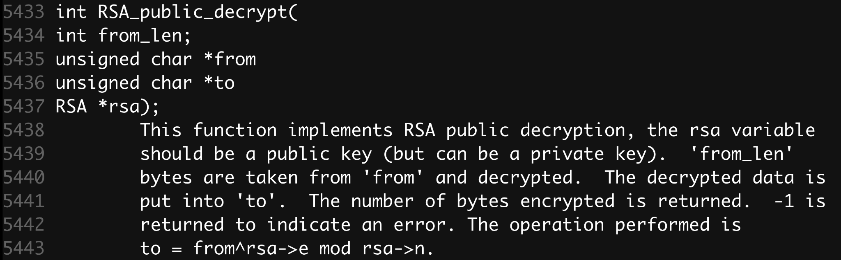
So long as we don’t need to worry about the padding scheme, there’s nothing to stop us from applying this function to entirely phony “ciphertexts” and seeing what it produces.

Slide 43
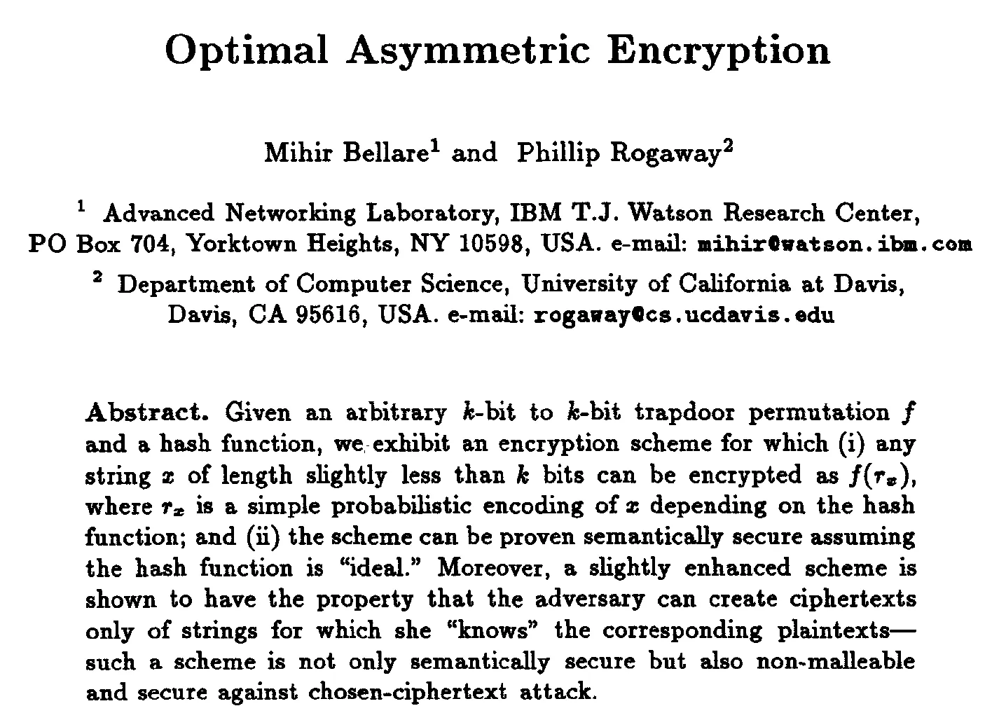
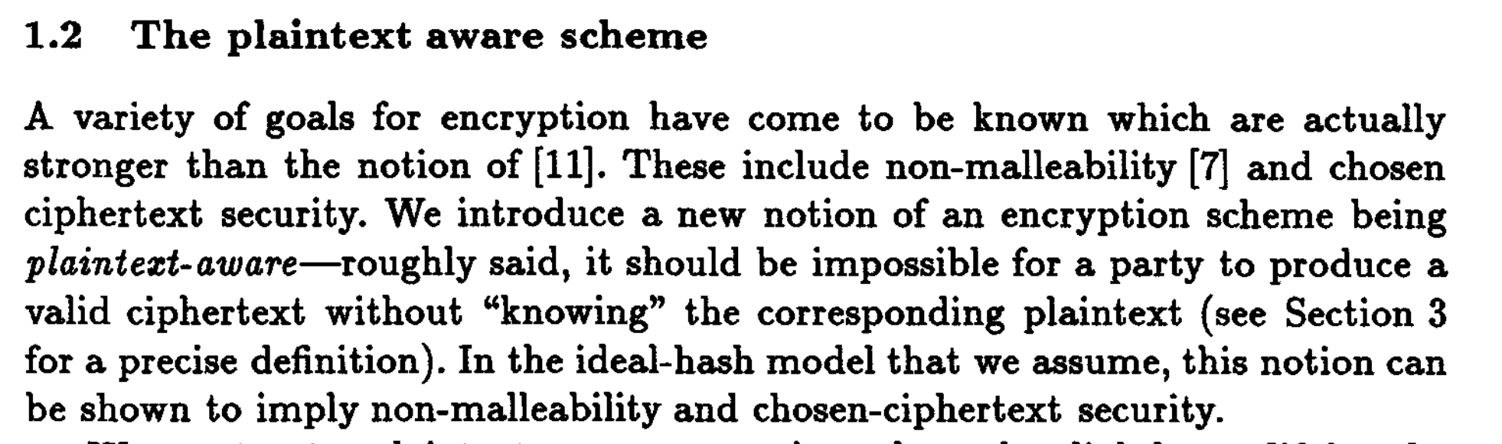
The main takeaway for us here is that unpadded RSA encryption is not “plaintext aware.”
It is possible for us to produce a valid ciphertext without “knowing” the corresponding plaintext.

Slide 44
So, if we can produce phony but “valid” ciphertext, knowing only the public key, what exactly do we want to do with that?
It seems that the telnetd_startup service places very few constraints on what the corresponding plaintext should be.
Little more than a string length check, which I think is redundant anyway. (It can’t be more than 256 characters long – but the key itself is only 1024 bits, which bounds the plaintext at 128 bytes.)

Slide 45
Remember that the random secret only contains printable characters.

Slide 46
So, if we randomly generate a nonce that “decrypts” to an array of bytes that BEGINS with a printable character, then we have a 1-in-94 chance of causing an XOR collision that makes XORED_MSG_00414b80 begin with a null byte!
Remember that the random secret is then XORed with the “decrypted” nonce, which we control.
As far as the %s format string is concerned, that would make XORED_MSG_00414b80 an EMPTY STRING!

Slide 47
DEMO TIME

Slide 48
Are other models and
firmware versions affected?

Slide 49
Are other models and
firmware versions affected?
To find out, I ordered Phicomm’s newest consumer router from Amazon, the K3C, and while I waited for it to arrive, I painstakingly scoured Chinese language router hacking forums for as many leaked firmware blobs as I could find.
I identified three different variations of the backdoor protocol.

Slide 50
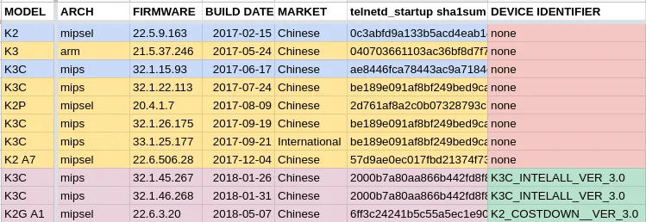
Reconstructing the History of
Phicomm’s Backdoor Protocol

Slide 51
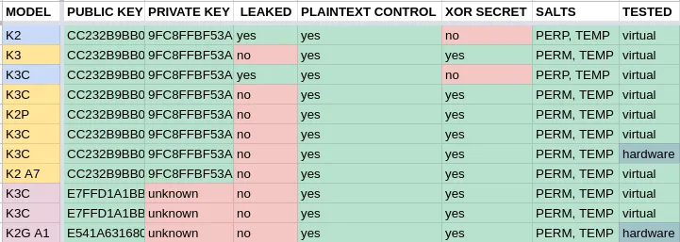
Reconstructing the History of
Phicomm’s Backdoor Protocol

Slide 52
Backdoor Protocol: Version 1

Slide 53
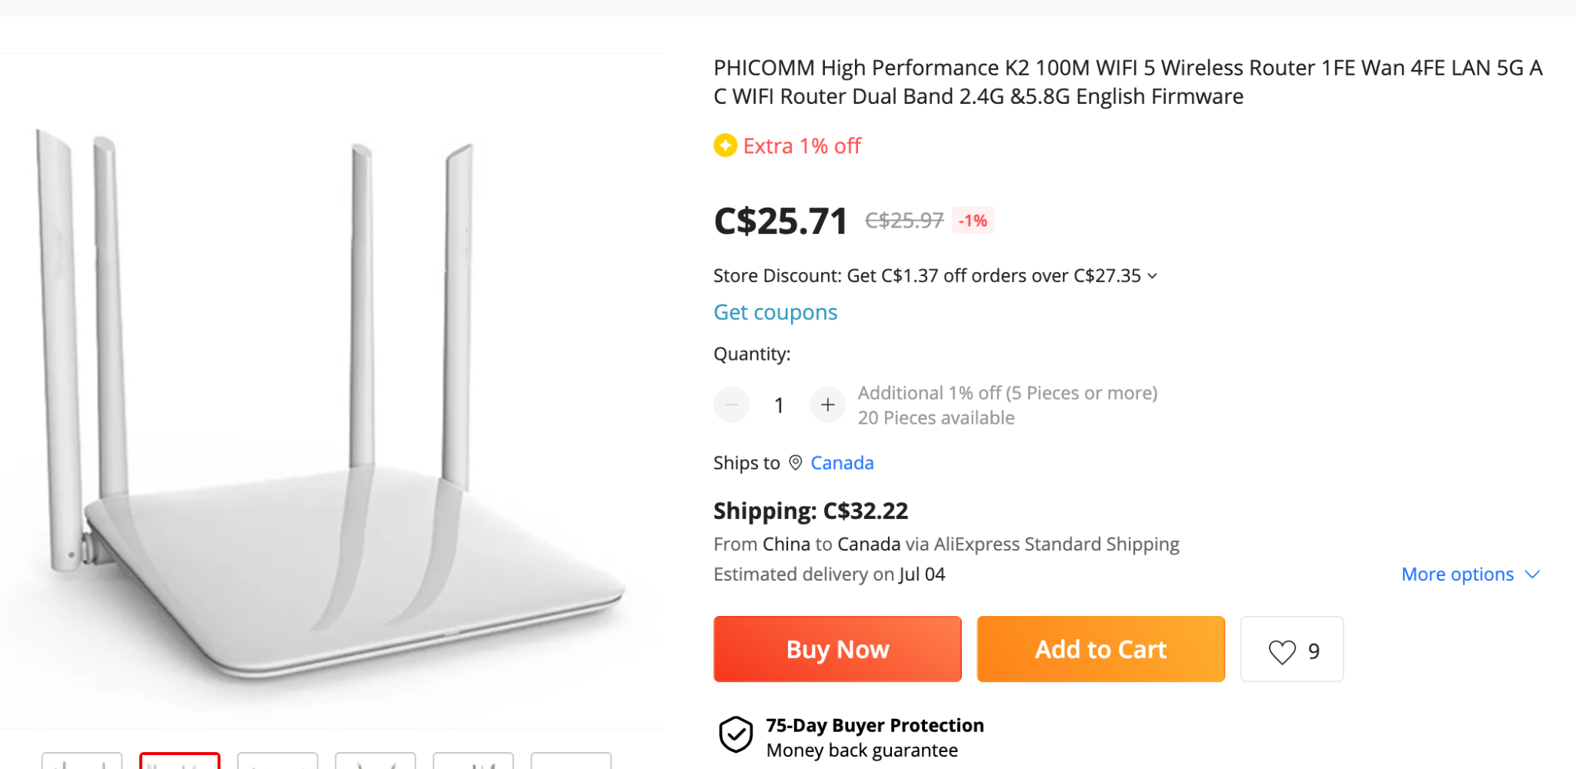
As found on the Phicomm K2 router with firmware version 22.5.9.163 (built in February, 2017).

Slide 54
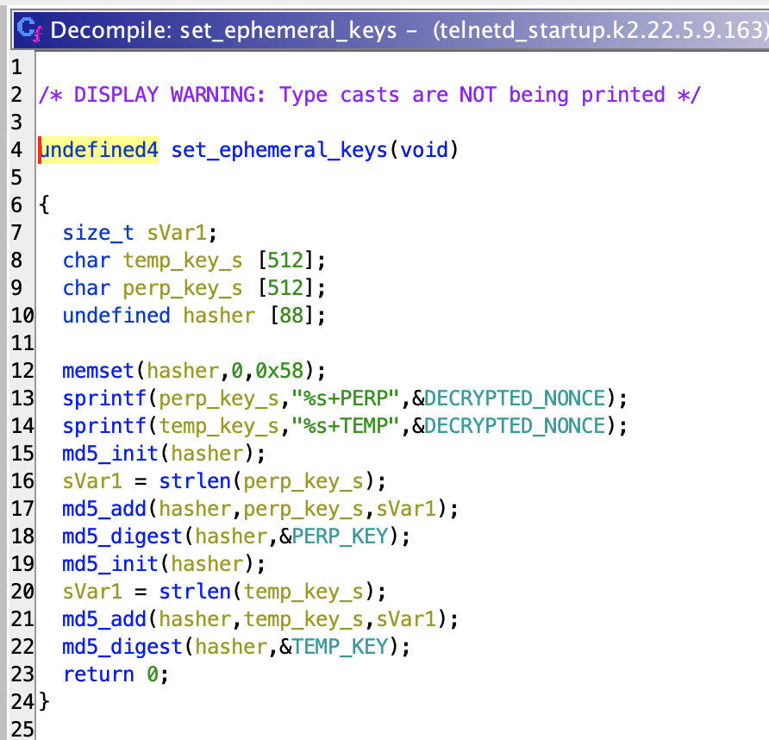
Here, the ephemeral keys are just the MD5 hashes of the decrypted nonce provided by the client, concatenated (in the same insecure way) with the special salts.
(With one variation: “PERM” is spelled “PERP” in this build.)
No random plaintext is used, no XOR operation is performed. This is easy to exploit with a null byte injection even if you don’t have the private key…

Slide 55
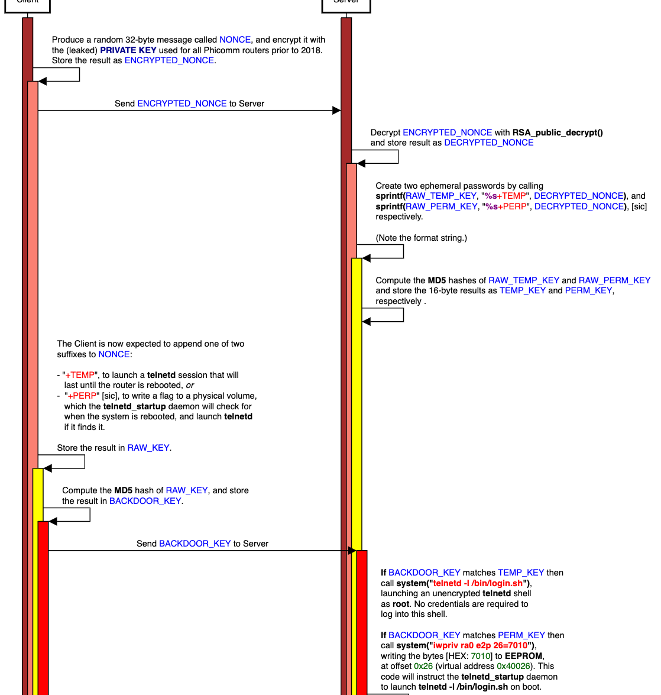

Slide 57
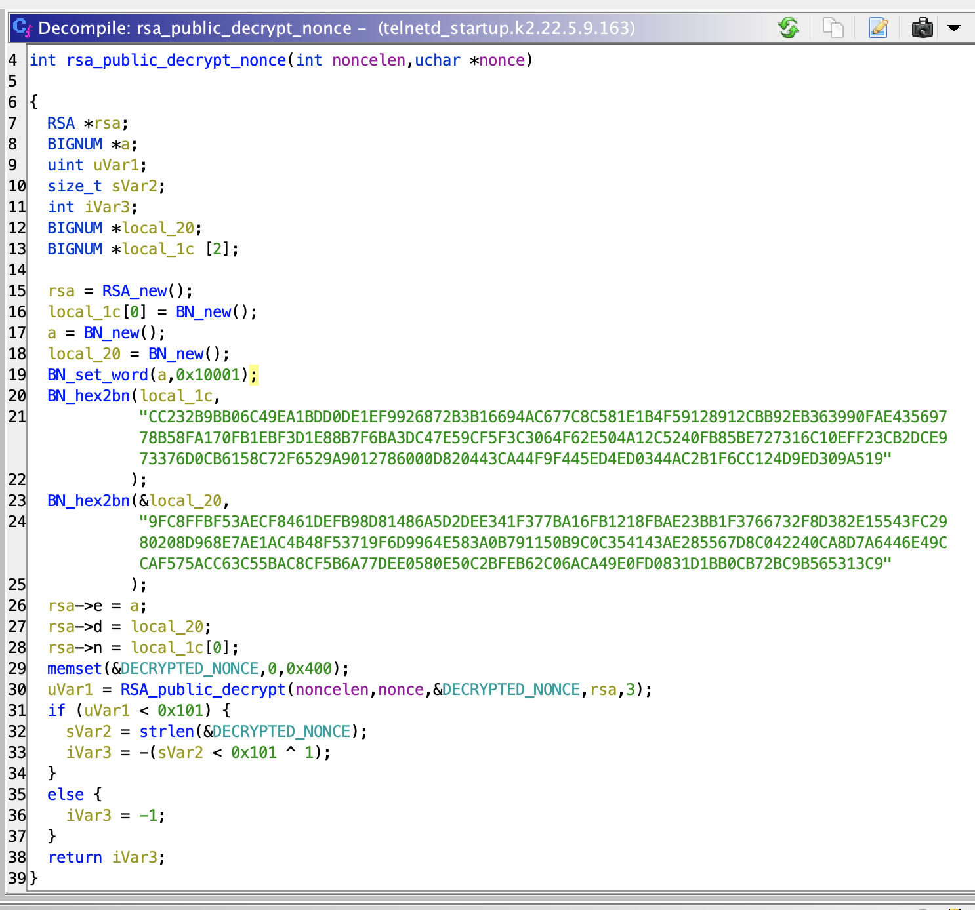
The most obvious flaw in the oldest version of the backdoor that I was able to find is that Phicomm baked the private RSA key into the telnetd_startup binary!
This was a completely unforced error. The binary doesn’t even use the private key.
Here’s the Ghidra decompilation for rsa_public_decrypt_nonce() in the telnetd_startup that shipped with the Phicomm K2, fw version 22.5.9.163.

Slide 58
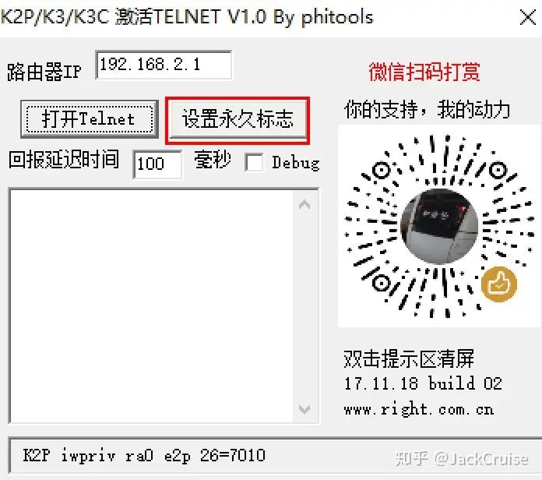
Tools for Exploiting this Version of the Backdoor Exist in the Wild
Hackers were quick to notice this mistake, and a tool for gaining an unauthenticated root shell appears widely on Chinese language router forums.

Slide 59
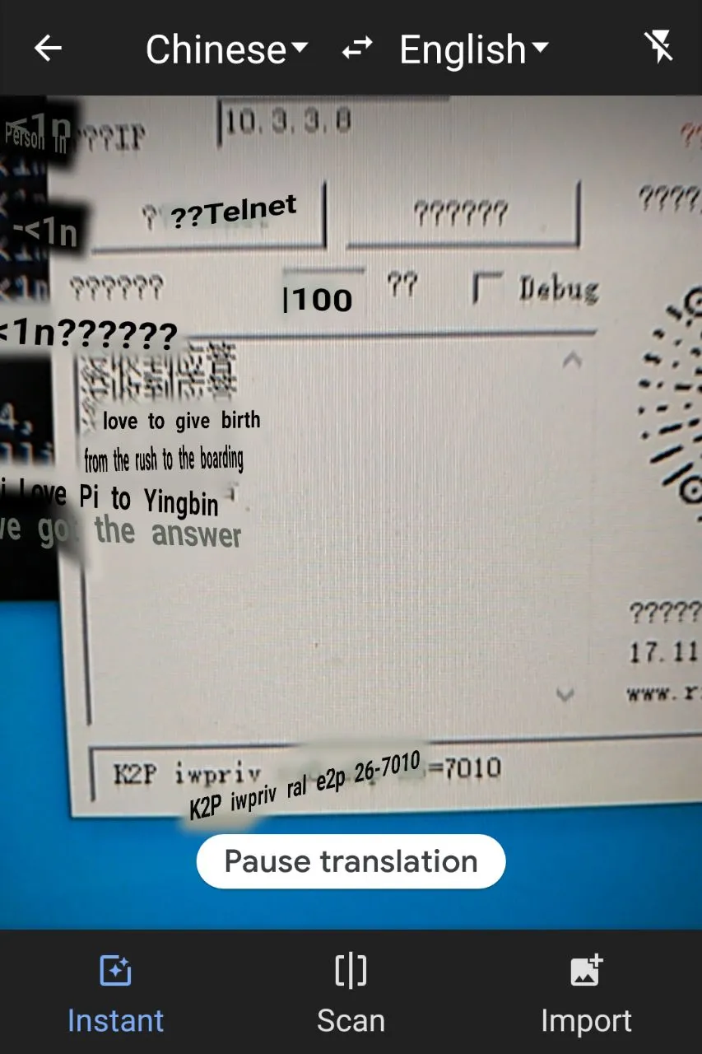
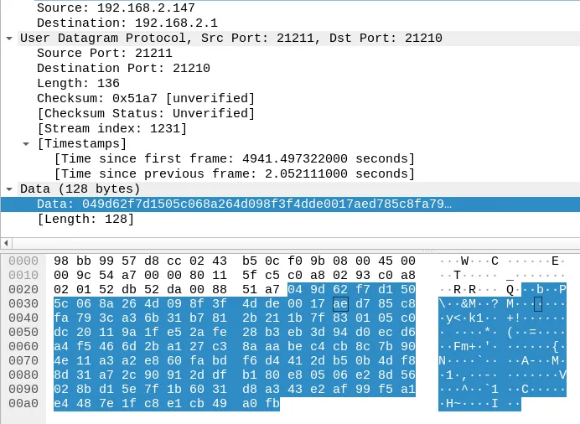
I spun up a Windows VM, launched RoutAckPro, and sniffed.

Slide 60
Backdoor Protocol: Version 2

Slide 61

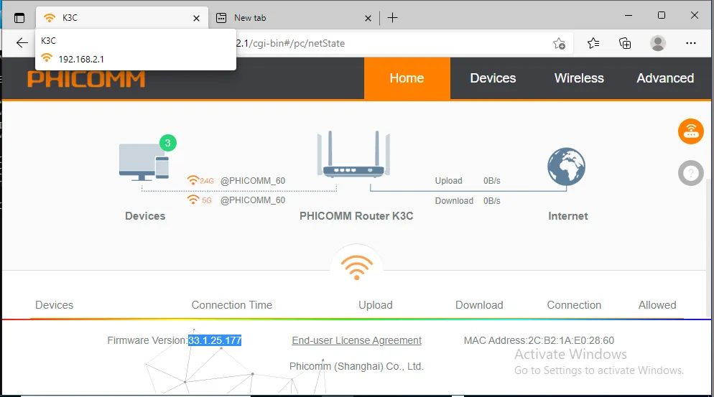
I bought an international release of the Phicomm K3C router off Amazon, to see if it had a similarly vulnerable backdoor.
This one is running firmware version 33.1.25.177

Slide 62
Honestly, this brand new K3C International edition, running 33.1.25.77, was my first clue that there are indeed variations in the backdoor protocol from one Phicomm device to another.
The tool that worked so well on the (half-assedly rebranded) K2G, seen earlier, would not work on this device without modifications.

Slide 63
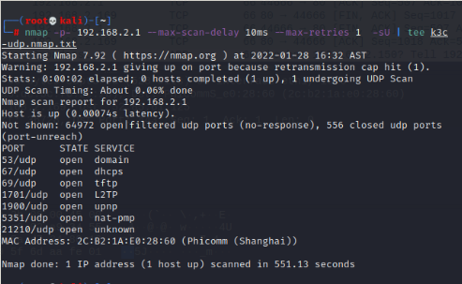
The Phicomm K3C did indeed have a service listening on UDP port 21210, but instead of responding to “ABCDEF1234” with a device-identifying MD5 hash, it would respond to any message with 128 bytes of high-entropy data.
I needed to get inside the device to take a closer look.

Slide 64
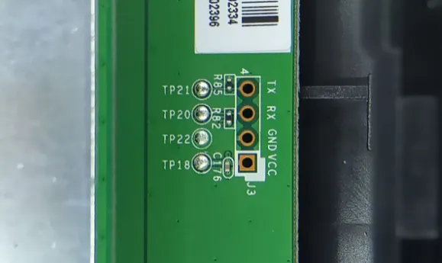
I wanted to access the filesystem, and ideally get a shell.
The web interface didn’t share the K3G A1’s command injection vulnerability…
but I did find a UART port.

Slide 65
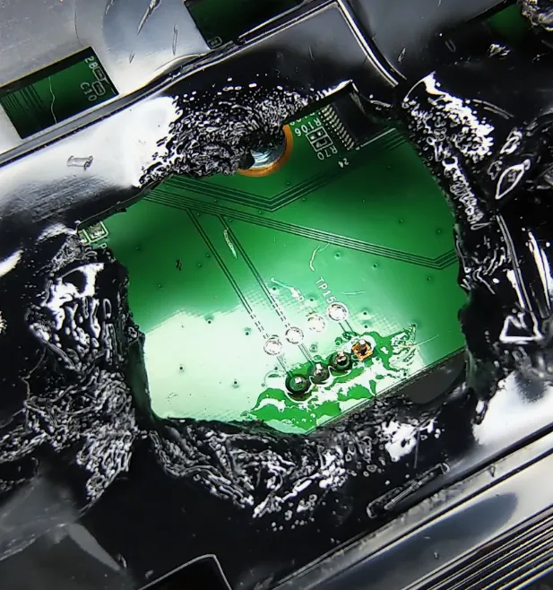
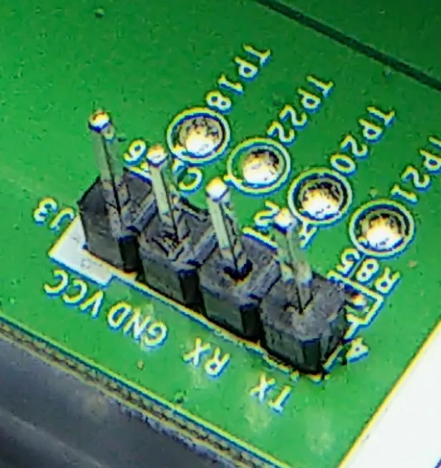
Don’t worry, I opened a window.

Slide 66
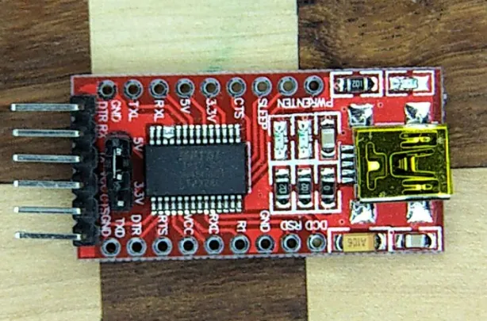
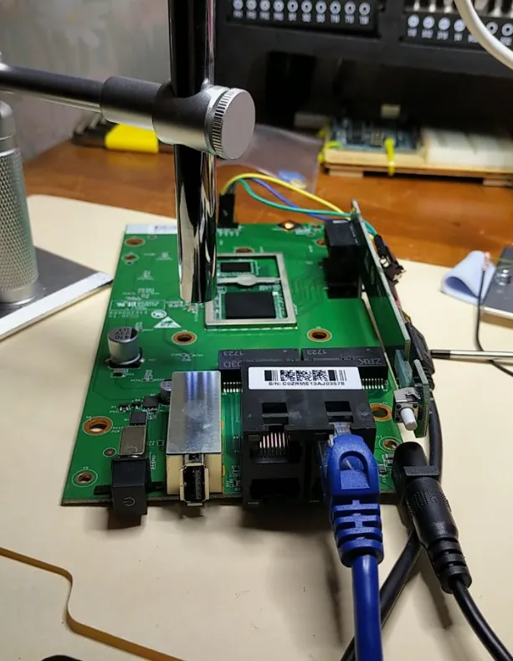
I set up my UART-to-USB bridge and got to work.

Slide 67
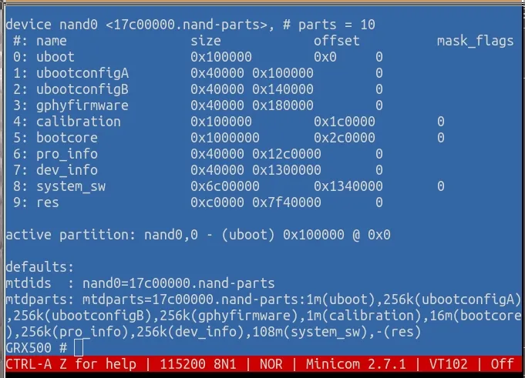
Interrupting the boot process gave me unauthenticated access to a UBOOT shell, from which I could dump the NAND storage.

Slide 68
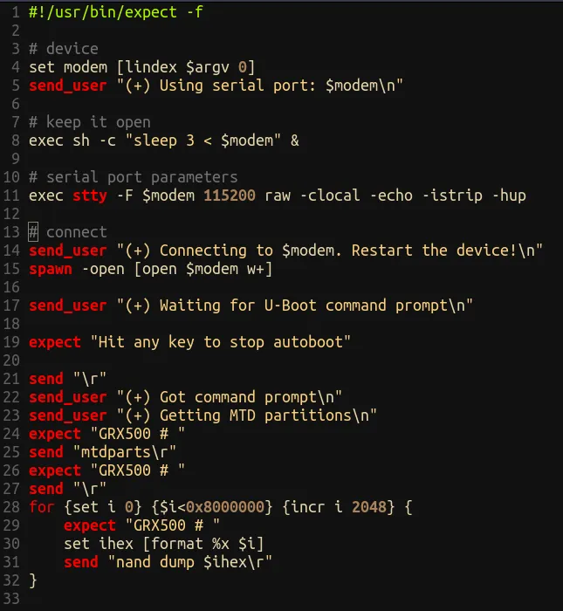

I found and modified a TCL expect script by someone named Valerio, and used it to hexdump the NAND while I got some rest.
Most of the NAND dump appeared to contain very high-entropy data, likely encrypted or compressed.
But there were a few valuable bits of information in the clear…

Slide 69



A /etc/passwd file, for example!
…from which hashcat could easily recover the root password for the device.
I rebooted the device and logged in as root, over UART.

Slide 70

Imagine my delight (mild disappointment) when I loaded this device’s telnetd_startup into Ghidra, and saw that it hadn’t even been stripped!
The state machine looks almost exactly like what we saw in the K2G A1, but without the ABCDEF → DEVICE_ID exchange.

Slide 71




Ghidra will not automatically load the region of this big-endian MIPS binary where certain important data is stored, such as the hardcoded public RSA key used by the service.
Here’s rsa_public_decrypt_nonce() from the k2.22.5.9.163
Let’s be lazy here, and call on the reverser’s favourite tool: strings.
It’s the same public key that they used for the K2.22.9.163!
They redacted the private key, but left the public key unchanged.
Does this look familiar?

Slide 72
But it’s cool, we don’t actually need the private key to pop this version of the Phicomm backdoor.
We can use the same trick we used for the K2G A1, and just skip the ABCDEF → DEVICE_ID exchange.
(Note to self: now is a good time to plug in the K3C.)

Slide 73


Slide 76
DEMO TIME
Part Deux

Slide 77
Backdoor Protocol: Version 3
(Back where we started.)

Slide 78
This seems to be when it dawned on Phicomm that the internet is slow to forget a leaked private key, and that it was time to switch things up.
The third version of the protocol includes the
ABCDEF1234 → DEVICE_ID exchange, and each device ID seems to have its own pair of RSA keys.
The public key is baked into the telnetd_startup binary, and the private key seems, in each case, to have been successfully kept as a secret, but is presumably used by officials (?) to gain a root shell on the router.

Slide 79


Slide 80


Slide 83

The Responsible Disclosure Process

Slide 84
I set out to find someone at Phicomm with whom I could discuss these vulnerabilities, and inform them of Tenable’s 90-day coordinated disclosure protocol.
Generally speaking, we notify the vendor that we’ve found a 0-day, and tell them that if they respond, we will disclose in 90 days time, or as soon as we learn that the vulnerability has been patched.
We also tell them that we will disclose in 45 days time if we receive no reply.

Slide 85



Slide 86

I tried to reach out over other channels, but the situation did not look promising.

Slide 87


Slide 88

So, what happened?
2008: Gu Guoping founds Shanghai Feixun, which will later be known as “Shanghai Phicomm”
2012: Lianbi Financial founded by ????
2014: Phicomm declares operating income of 10 billion yuan (about $1.5 billion USD), dubbed “Little Huawei” in the Chinese press.
2014: Phicomm initiates merger with Huiqiu Technology (formerly Beisheng Pharmaceutical)
2015: Guoping gains control of Lianbi Financial
2015: Phicomm launches “0-yuan purchase plan”
2016: Huiqiu discloses that Guoping had gained control of the company. Guoping’s affiliate Xianyan receives largest fine in history from China Securities Regulatory Commision (about $500 million USD)
2016: Guoping claims to have lost financial control of Phicomm

Slide 89
The “0-yuan Purchase Plan”
Essentially, the deal was that you could apply for a full rebate on the purchase of Phicomm routers and IoT devices if you register for the Lianbi Financial and Huaxia Wanija Financial Peer-to-Peer lending Apps.

Slide 90


Further Reading…

Slide 91


2018-06: Lianbi Financial filed on suspicion of “illegally absorbing public deposits” (i.e. running a Ponzi scheme) – Gu Guoping is arrested.
2021-02-04: Shanghai No. 1 Intermediate People’s Court holds public hearing for fraud case against Guoping
2021-06-23: Songjian Police arrest Lianbi personnel

Slide 92

“On the morning of December 8, the Shanghai No. 1 Intermediate People’s Court publicly sentenced the defendants Gu Guoping, Nong Jin, Chen Yu, Zhu Jun, Wang Jingjing, and Zhang Jimin on the case of fundraising fraud. Gu Guoping was sentenced to life imprisonment for the crime of fundraising fraud, deprived of political rights for life, and confiscated of all personal property.”

Slide 93
To make a long story short, we should not expect patches.

Slide 94
Thank You!
Olivia Lucca Fraser
Staff Research Engineer on Tenable’s Zero Day Research Team
github.com/oblivia-simplex

Slide 96

2017: a Cayman Island holding company “Talent Transmission Limited” (MH96960), in concert with Phicomm, acquires almost $1 billion USD worth of UTStarcom Holding Corp shares. (UTStarcom is also in the router business.)

